Slide 1
Brute forcing Diffie-hellman across different hardware platforms
Csc487-Final project

Slide 2
Introduction
Objectives
Background
”The Paint Analogy”
Program Explanation
Results

Slide 3
objective
The "Objective" of this assignment is to implement and evaluate the cost in terms of time for three different computer hardware's to crack a Diffie-Hellman key exchange using a small prime number (p) and a base (g). Students are required to:
Choose a small prime number p and a base g that is a primitive root modulo p.
Verify that p is a prime number.
Verify that g is a primitive root modulo p.
Perform and measure the time it takes for a brute-force attack to guess a secret number used in the Diffie-Hellman key exchange.
Repeat the brute-force attack multiple times to find an average duration.
Conduct this experiment on three different types of computer hardware to compare the computational cost.

Slide 4


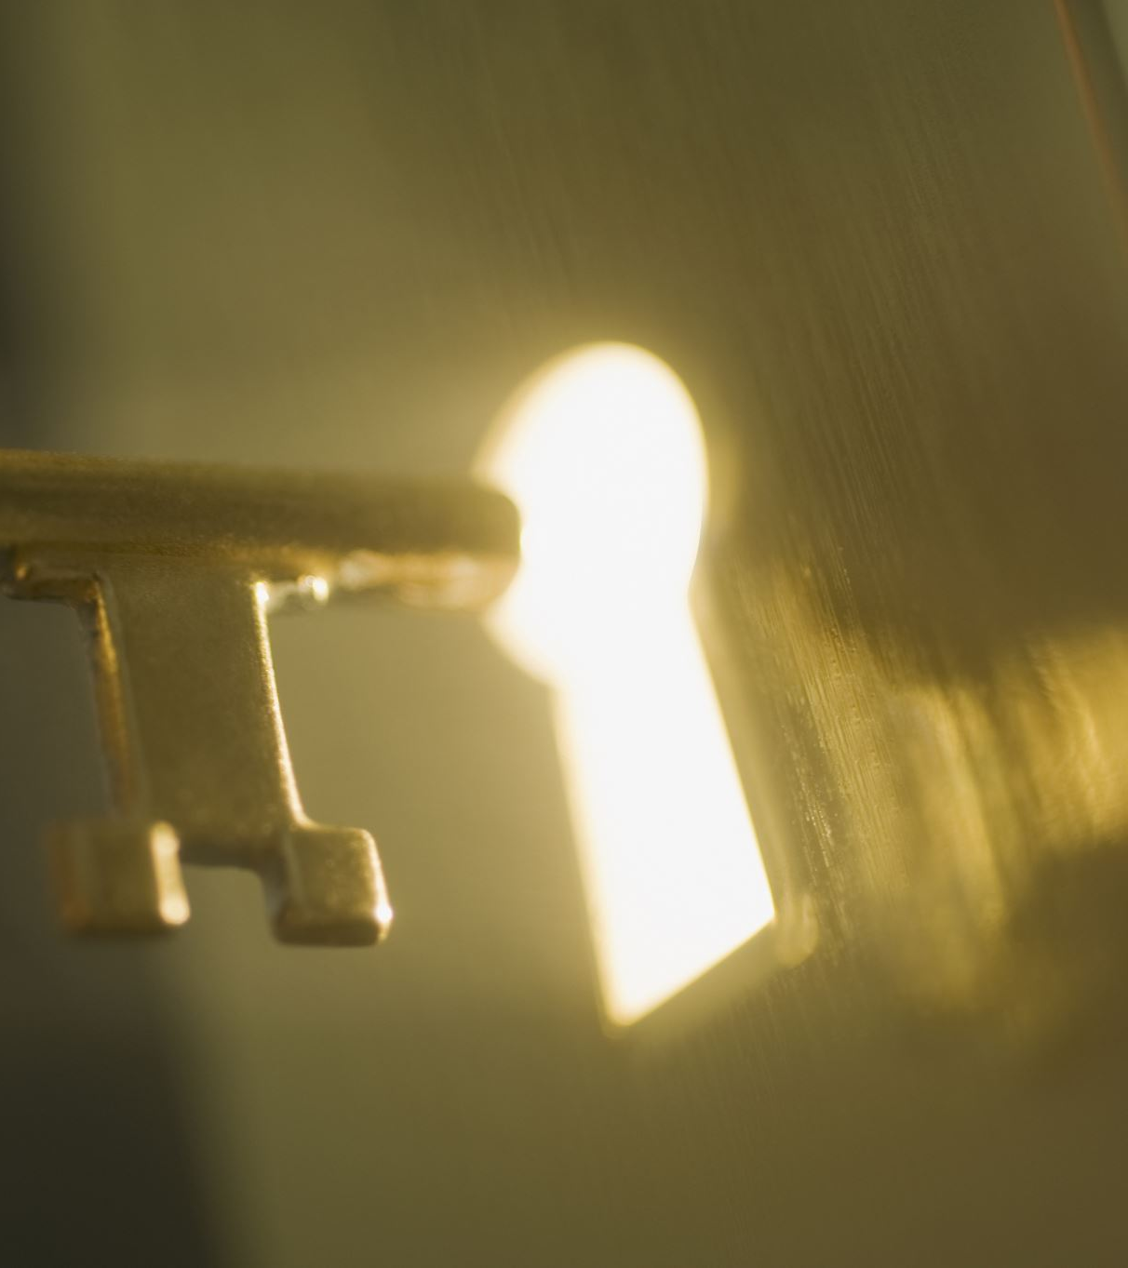
Background
Diffie-Hellman Key Exchange: It's a method for two parties to create a shared secret key over an insecure channel, relying on the hard-to-solve discrete logarithm problem for its security.
Practical Implementation: Each party picks a private key and shares a derived number publicly. When they each raise the other's public number to their own private key, they arrive at the same secret value, which can be used for secure communication.
Importance of Large Private Keys: The private key's large size in the Diffie-Hellman exchange is vital for security because it makes solving for the key from public information very difficult, hence the key should be randomly chosen and kept secret.
Diffie-Hellman vs. RSA: Diffie-Hellman is only for generating a shared secret key based on the discrete logarithm problem, while RSA handles encryption, decryption, and digital signatures using key pairs, based on factoring large primes.
Usage of Diffie-Hellman: It is used to create a shared secret key over an insecure channel, enabling secure communication using symmetric encryption, which is efficient for encrypting large data volumes.

Slide 5
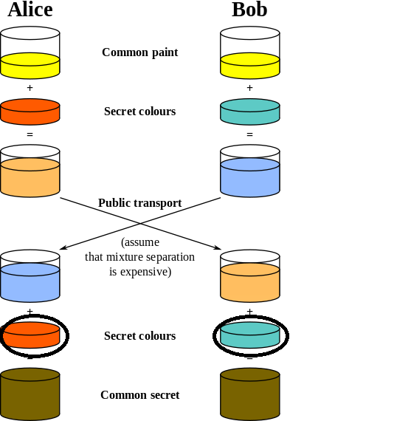
The Paint analogy
Yellow: This is the common base, g. Assumed to be known by Alice, Bob, and eavesdroppers.
Orange(Amber): Alices private key, ‘a’. Typically very large and random. Not shared with anyone.
Blue(Teal): Bob’s private key, ’b’. Typically very large and random. Not shared with anyone.
Light orange(A) = gª mod p
Han Blue(B) = g^{b} mod p
The mixed colors, light orange/brown and han blue, are then sent across public space. DH relies on “dissolution” of colors to be untenable.
Alice derives amber color again by performing Bª mod p.
Bob derives teal again by performing A^{b} mod p.
This is possible because in modular arithmetic, Bª mod p and A^{b} mod p, are equal to g^{ab} mod p = g^{ba} mod p. Notice how order of exponentiation doesn’t affect the result.
However, since both of their mixtures now have each other’s shared secret in them(without either party knowing what it is) when they add in their original private key’s they get the common secret.
s = (gª)^{b} mod p = (g^{b})ª mod p = g^{ab} mod p

Slide 6
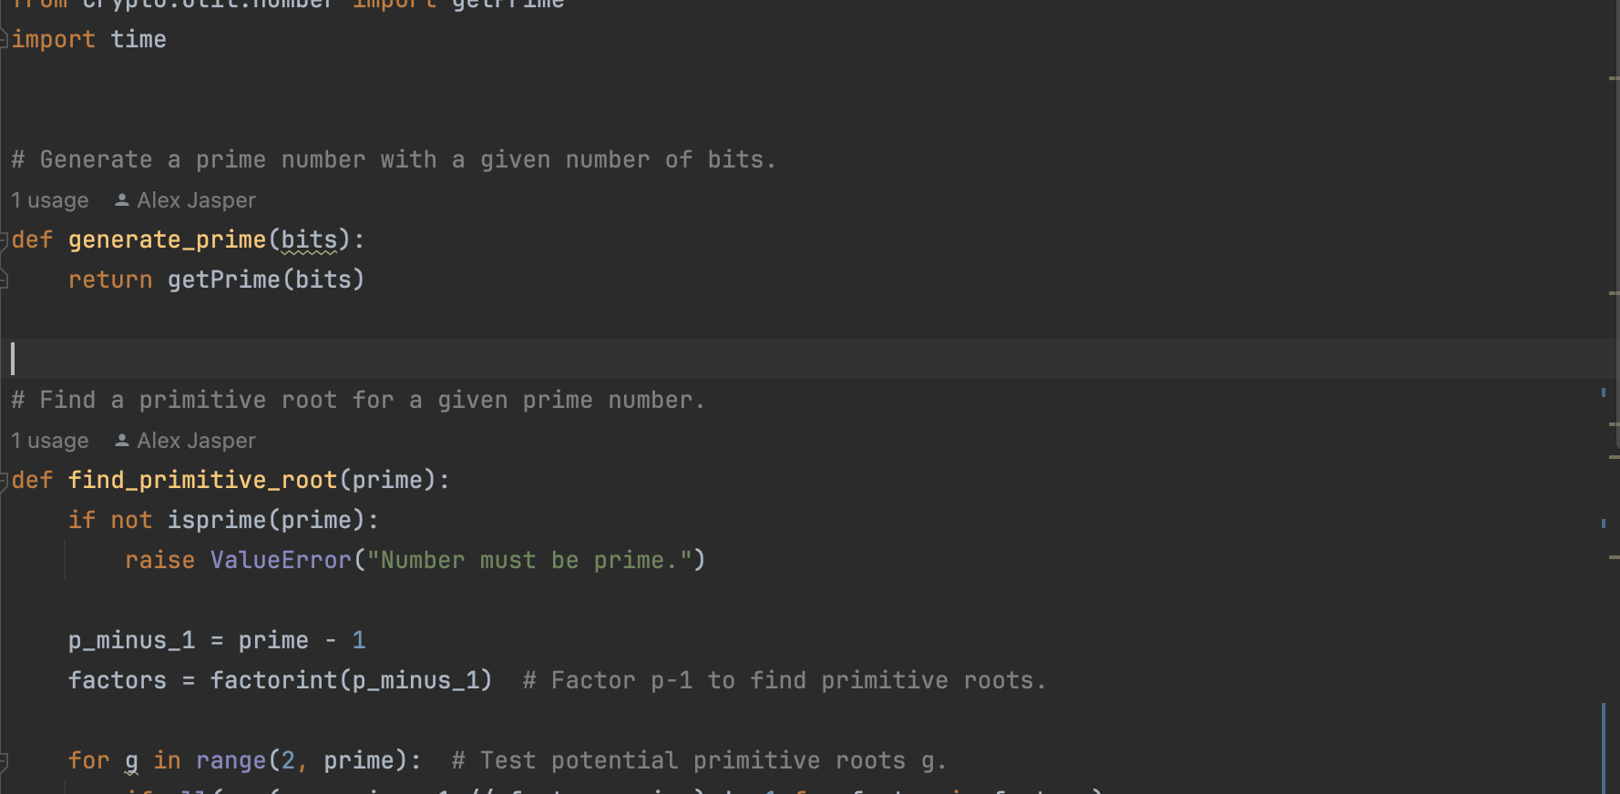
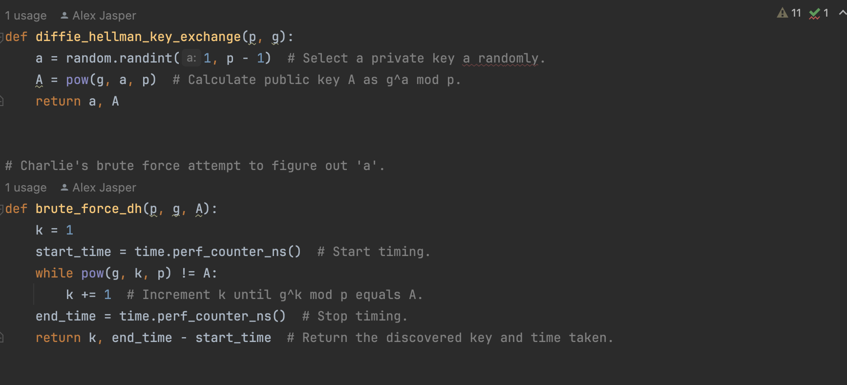
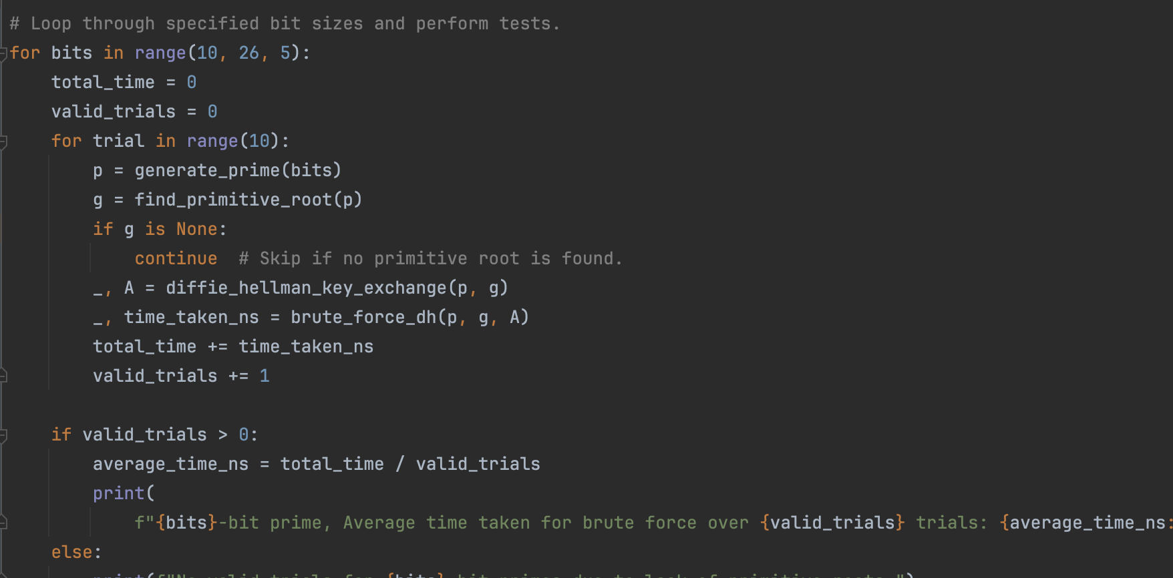
Program explanation
generate_prime(bits): Generates and returns a prime number with a specified number of bits using a cryptographic library.
find_primitive_root(prime): Identifies and returns a primitive root modulo a given prime number, which is necessary for certain types of cryptographic protocols; it raises an error if the input number is not prime.
diffie_hellman_key_exchange(p, g): Implements one step of the Diffie-Hellman key exchange by generating a private key 'a' randomly and computing the corresponding public key 'A’ as mod gª mod p.
brute_force_dh(p, g, A): Attempts to reverse-engineer the Diffie-Hellman key exchange by brute-forcing the computation of 'a' given 'p', 'g', and 'A'. It also measures the time taken to find ‘a’.
Summary: The program evaluates the security of the Diffie-Hellman key exchange by simulating it and then attempting to break it using brute force. It cycles through prime numbers of increasing bit size (10 to 30 bits, in 5-bit increments) to assess how the complexity of the brute force attack scales with the size of the prime number.

Slide 7
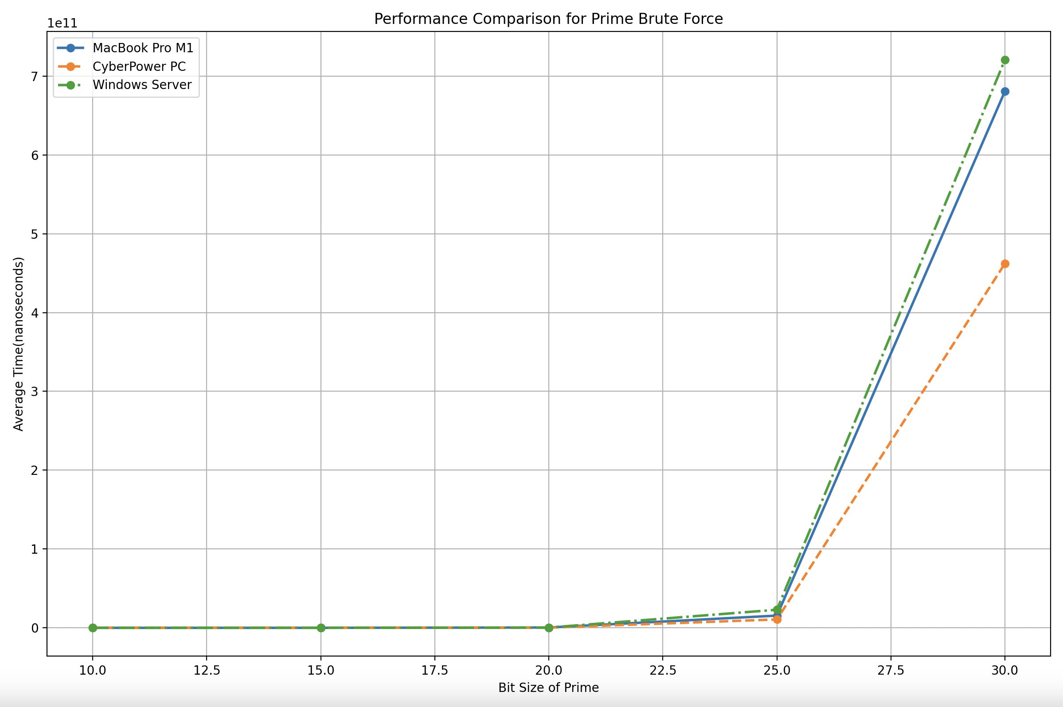
Results
MacBook Pro, M1 - macOS, Ventura
10-bit prime: 181,221 ns → 0 minutes, 0.0002 seconds
15-bit prime: 7,398,713 ns → 0 minutes, 0.0074 seconds
20-bit prime: 446,755,263 ns → 0 minutes, 0.447 seconds
25-bit prime: 15,536,839,833 ns → 0 minutes, 15.537 seconds
30-bit prime: 680,854,204,121 ns → 11 minutes, 20.854 seconds
CyberPower PC - Windows 11 Home
10-bit prime: 111,540 ns → 0 minutes, 0.0001 seconds
15-bit prime: 7,402,340 ns → 0 minutes, 0.0074 seconds
20-bit prime: 288,394,150 ns → 0 minutes, 0.288 seconds
25-bit prime: 10,667,809,000 ns → 0 minutes, 10.668 seconds
30-bit prime: 462,293,863,250 ns → 7 minutes, 42.294 seconds
Windows Server 2022 Datacenter
10-bit prime: 221,750 ns → 0 minutes, 0.0002 seconds
15-bit prime: 8,990,850 ns → 0 minutes, 0.0090 seconds
20-bit prime: 373,064,570 ns → 0 minutes, 0.373 seconds
25-bit prime: 22,977,646,390 ns → 0 minutes, 22.978 seconds
30-bit prime: 720,745,697,924 ns → 12 minutes, 0.746 seconds

Slide 8

Some reasons for performance differences
The differences in performance when brute-forcing a Diffie-Hellman private key between various hardware setups can be influenced by several factors. Here are a few possible prime suspects:
Processor Specifications
System Architecture
OS and Python Environment
Code Efficiency and Python Libraries
Variability in Prime Characteristics

Slide 9
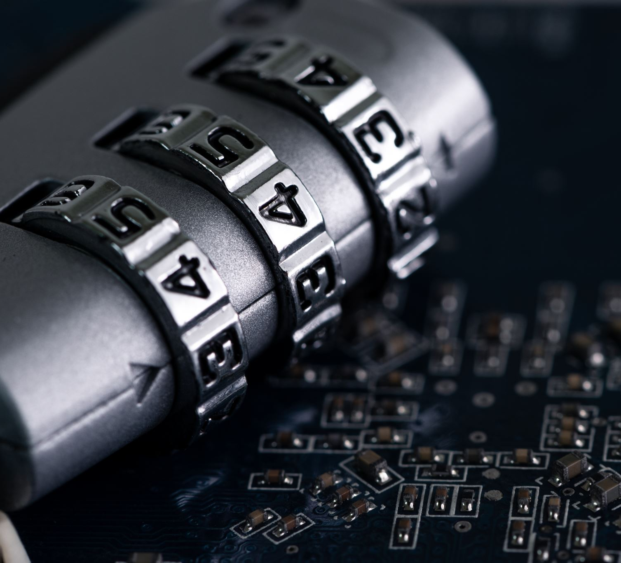
How exponential growth creates security & Some useful math
The difficulty of breaking Diffie-Hellman comes from the mathematical challenges of solving the Discrete Logarithm problem. While breaking 30-bit keys is feasible, larger keys are secure due to computational limits. Advancements in algorithms and hardware require larger key sizes for Diffie-Hellman to maintain security comparable to AES encryption. For instance, a 3072-bit DH key is considered to offer security equivalent to that of a 128-bit AES key.
Here is some useful conversions to keep in mind:
2¹⁰ is about 1 thousand
2²⁰ is about 1 million
2³⁰ is about 1 billion
2⁴⁰ is about 1 trillion

Slide 10
Math in action
Recall that our highest test bit DH key was 2³⁰ which is about a billion (~1.07 billion).
A billion is very computational feasible to brute force. Therefore, 2³⁰ is not secure.
Thankfully, key sizes go come in varying sizes with an increasing popularity of 3072(which is comparable security in terms of brute force time to AES-128).
Let’s go through a fun way to conceptualize what is meant by computational infeasibility of a brute force attack and how that’s a good thing for security.

Slide 11
Hypothetical Scenario
Average case time, means roughly half the key space is searched.
This means that for something like a 128-bit key we would need to test 2¹²⁸ / 2 = 2¹²⁷ keys.
Let’s assume we can test to see if a key is correct at a rate of one billion keys per second. How many years would it take to brute force?
Therefore if we have (2¹²⁷ keys) / (2³⁰ keys/second) = 2¹²⁷⁻³⁰ = 2⁹⁷ seconds
To make this number more digestible:
Given roughly 2²⁵ seconds in a year
2⁹⁷ seconds = 2⁹⁷ / 2²⁵ = 2⁹⁷⁻²⁵ = 2⁷² years.
Now recall: 2⁷² = 2⁴⁰ * 2³⁰ * 2²
Which can effectively be thought of as 4 trillion, billion years.
Or in other terms: 4,000,000,000,000,000,000,000 years.
Keep in mind estimated age of the universe is only around 13.7 billion years. [1]
Therefore, if we assume similar security from a 3072-bit DH key, even if we go lower end of 2048, it’s safe to say we still will have a good bit of security. Even 1024 DH provides good security but given improvements in algorithms, it’s not used as much. [2]

Slide 12
References
https://home.uncg.edu/cmp/faculty/srtate/481.s24/rand_estimation.html
https://security.stackexchange.com/questions/5487/is-1024bit-diffie-hellman-key-exchange-secure
https://www.sciencedirect.com/topics/computer-science/hellman-algorithm

